Slide 1
DESIGN OF FORMWORK AND CONSTRUCTION SAFETY
UNIT -1
INTRODUCTION

Slide 2
SYLLABUS
INTRODUCTION
LOADS AND PRESSURES
SHORING, FORMWORK AND ACCESSORIES DESIGN
SPECIAL FORMS AND FORMWORK SEFTY
SCAFFOLDING

Slide 3
CONTENTS
FORMWORK
TYPES OF FORMWORK
MATERIALS AND CONSTRUCTION OF COMMON FORMWORK AND FALSE WORK SYSTEMS
SCAFFOLDING SYSTEMS

Slide 4
WHAT IS FORMWORK?
Formwork is temporary mold into which concrete or similar materials are poured.
They mold the concrete to the desired size and shape and control its position and alignment.

Slide 5
Objectives of formwork
Quality
Safety
Economy

Slide 6
Types of Formwork
Based on Material
Based on the purpose

Slide 7
Based on the material
Timber formwork
Metal formwork
Plastic formwork
Insulating concrete form

Slide 8
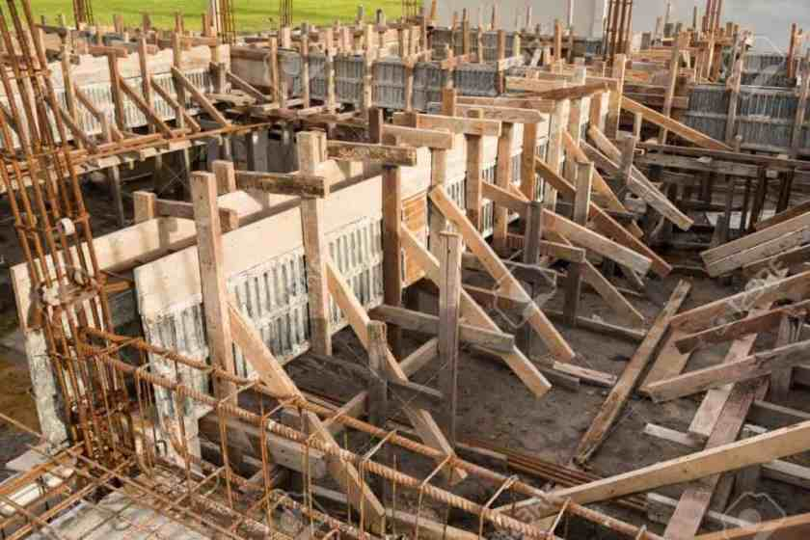
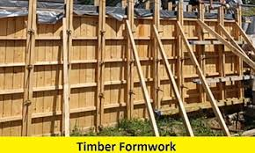
Timber formwork

Slide 9
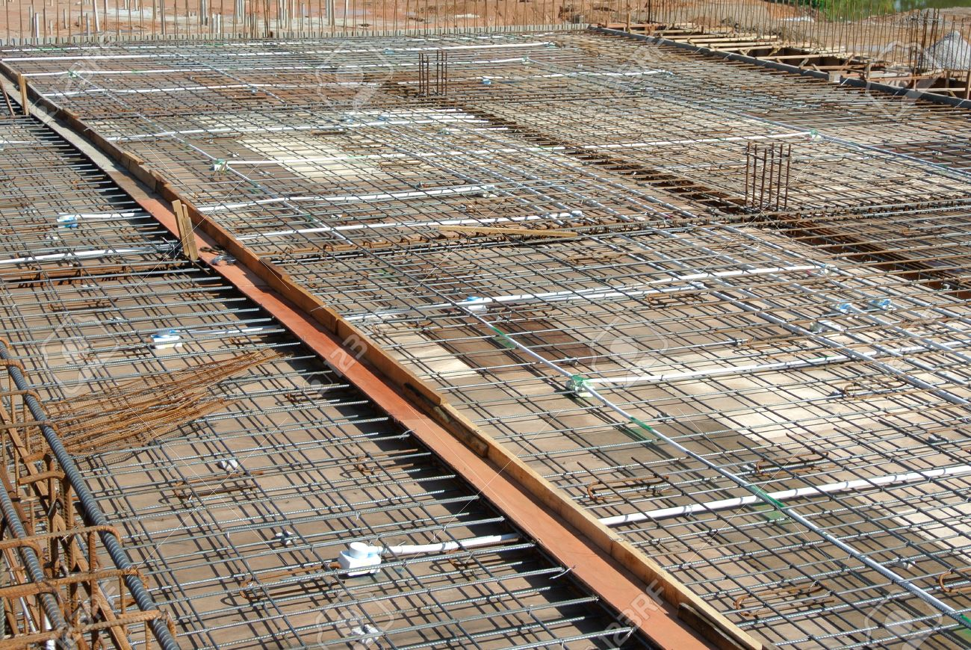
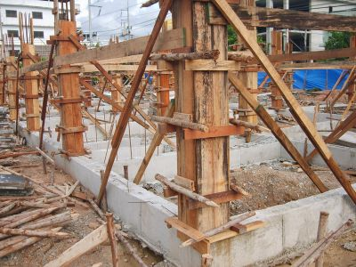
Timber formwork

Slide 10
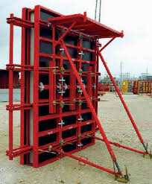
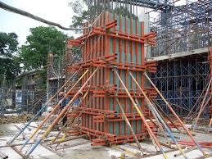
Metal formwork

Slide 11
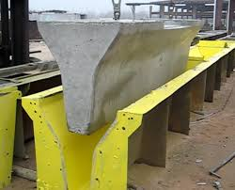
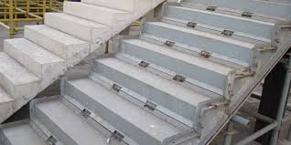

Slide 12
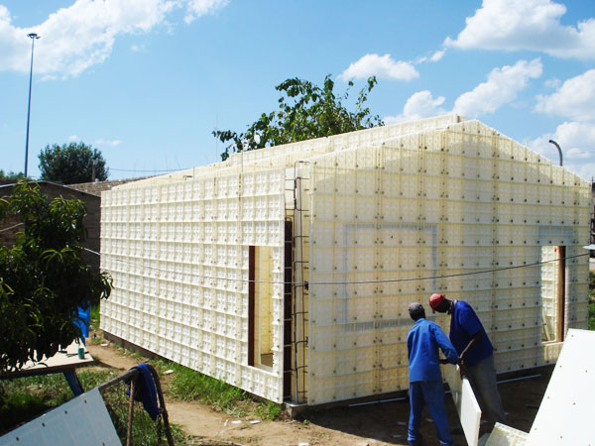
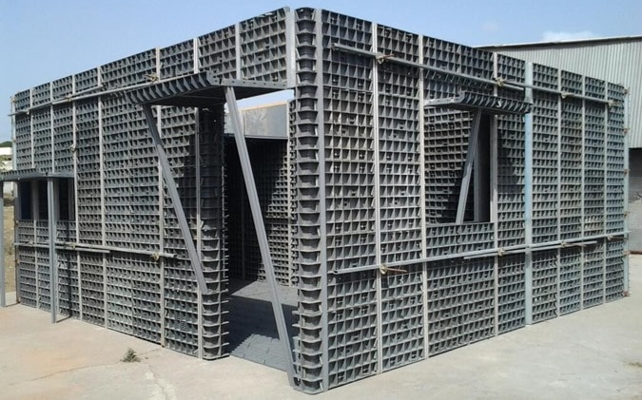
Plastic formwork

Slide 13
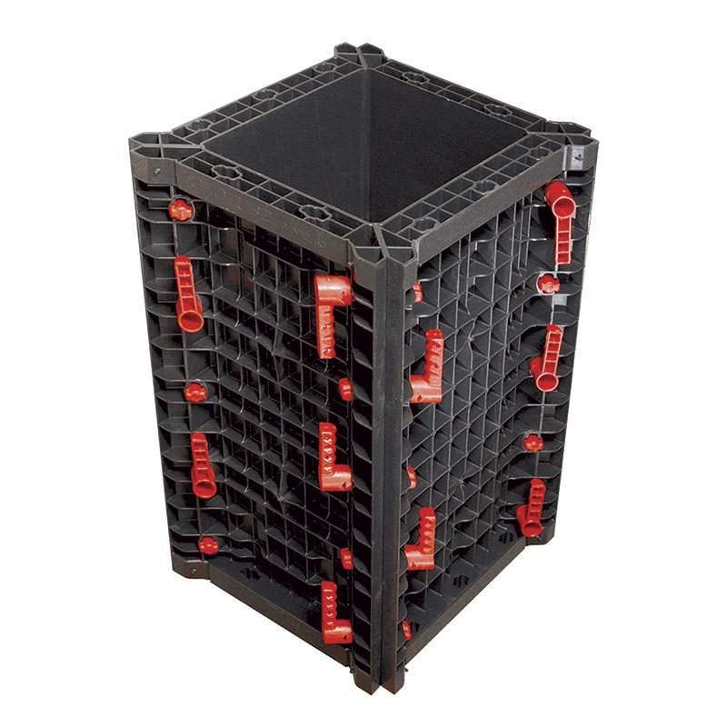
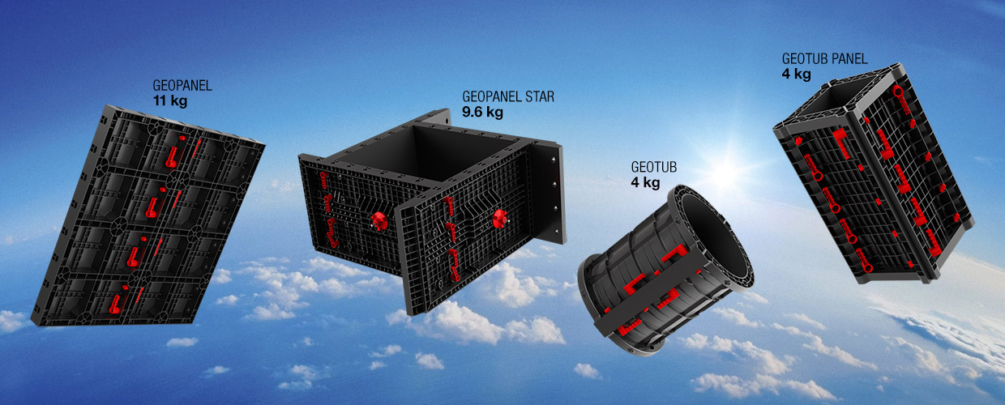

Slide 14
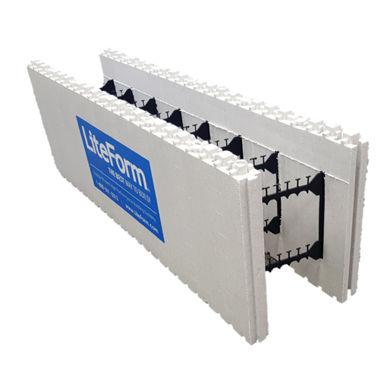
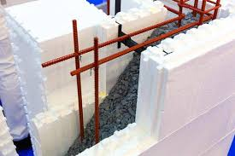
Insulating concrete form

Slide 15
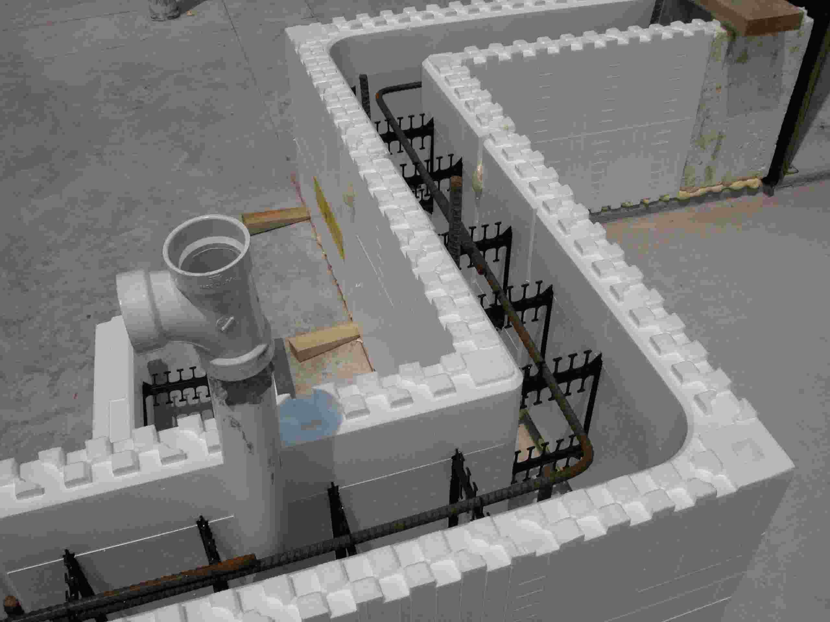
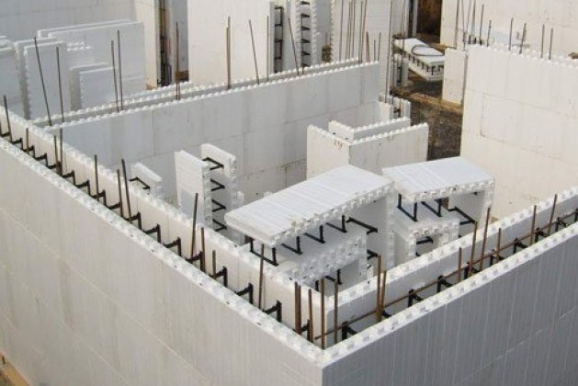

Slide 16
Based on the purpose
Column formwork
Beam formwork
Slab formwork
Wall formwork

Slide 17
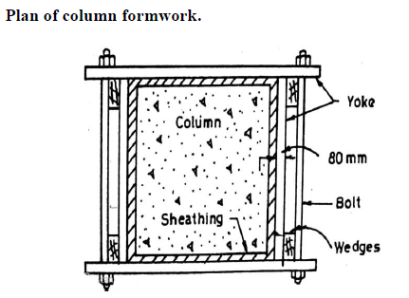
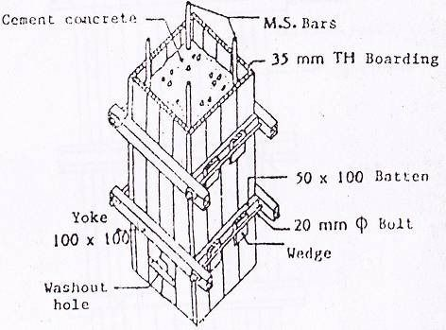
Column Formwork
It consists of
Side and end plates
Yoke
Nut and Bolts
Two ends and two side plates are joined by yokes and bolts

Slide 18
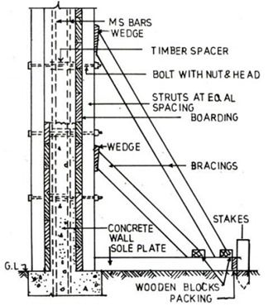
Formwork for wall
It consists of
Timber sheeting
Vertical posts
Horizontal members
Rackets
Stakes
Wedges

Slide 19
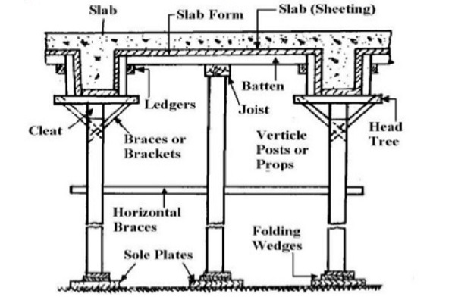
Formwork for wall and slab
It consists of
Sole plates
Wedges
Props
Head tree
Planks
Battens
Ledgers

Slide 20
Falsework
False work is temporary structure used to support the forms of concrete.
Falsework support the forms until the concrete can support itself.
It is essential that falsework be strong enough to support the weight of three thing: the forms, the fresh concrete and any construction equipment and workers.

Slide 21
Difference between formwork and falsework
Formwork typically consists of temporary moulds to keep the shape of concrete until it hardens.
Falsework refers to temporary constructions – such as props or scaffolding – to support arched or spanning structures by holding them in place until they can support themselves. When falsework is used for arches, it’s often called centring.

Slide 22
Materials used for falsework
A range of materials can be used for falsework, as long as they are strong enough.
Traditionallly, timber was used for all aspects of falsework.
Nowadays, proprietary aluminium or steel systems are popular.
Typical falsework include:
Aluminum support legs and frames.
Aluminium or steel props with timber beams or proprietary panets.
Heavy steel falsework.

Slide 23
scaffolding
Scaffold is a temporary structure, stage, or elevated platform that serves to aid construction and maintenance projects at a height. With progress in the construction industry, and so many different styles of architecture, various types of scaffolding systems are in use.

Slide 24
Types of scaffolding systems
Modular scaffolding
Tubular scaffolding
Suspended scaffolding
Single scaffolding
Cantilever scaffolding
Mobile scaffolding
Trestle scaffolding
Aerial lifts

Slide 25
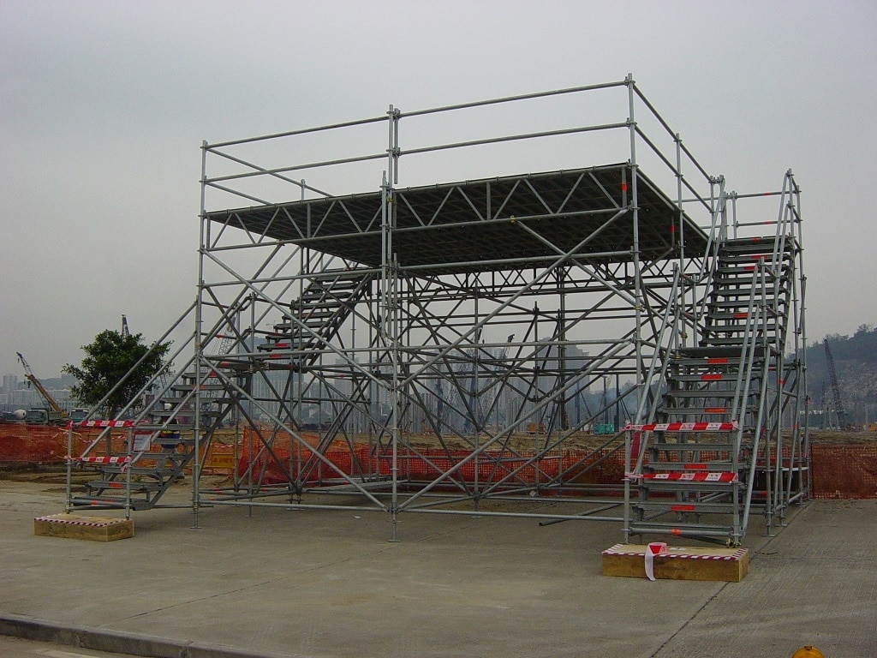
Modular scaffolding
A modular scaffold employs vertical, horizontal, and diagonal posts and tubes. Fixed linking points are spaced on the vertical post to which a horizontal or diagonal tube can be easily connected. A system scaffold uses a latch mechanism that makes it much quicker to erect, as compared to a tubular scaffolding.

Slide 26
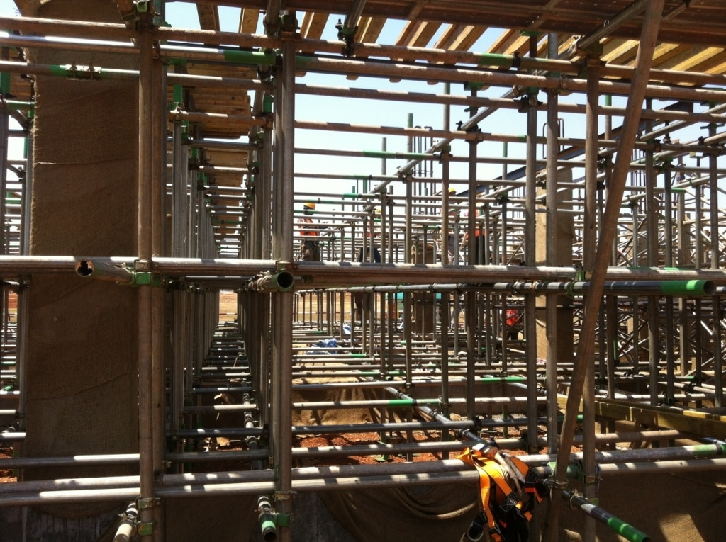
Tubular scaffolding
Tubular scaffolding is also referred to as steel scaffolding, tube and clamp scaffolding, tube and fitting scaffolding, or tube and coupler scaffolding. It is a traditional scaffolding system which is still in use by many because of the total flexibility that it provides.
Tubes and fittings are connected to each other with the help of clamps and couplers. As compared to modern scaffolding, tube and clamp scaffolding is much more time and labor intensive.

Slide 27
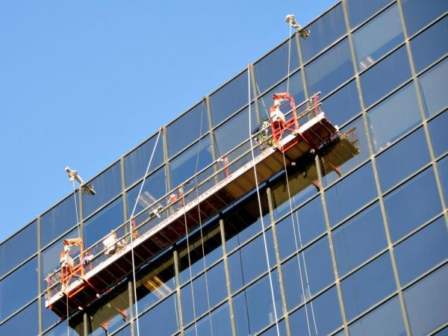
Suspended scaffolding
suspended scaffolding is that which is suspended or hung from an overhead structure, such as a ceiling. It is ideal in situations where very tall structures are involved and erecting a regular scaffolding system will require unnecessary time, money, and energy.
Suspended scaffolds are usually powered, and supported by ropes. There are eight types of suspended scaffolds including catenary, float, multi level, Botswain’s Chair, and swing scaffold which is the most popular.

Slide 28
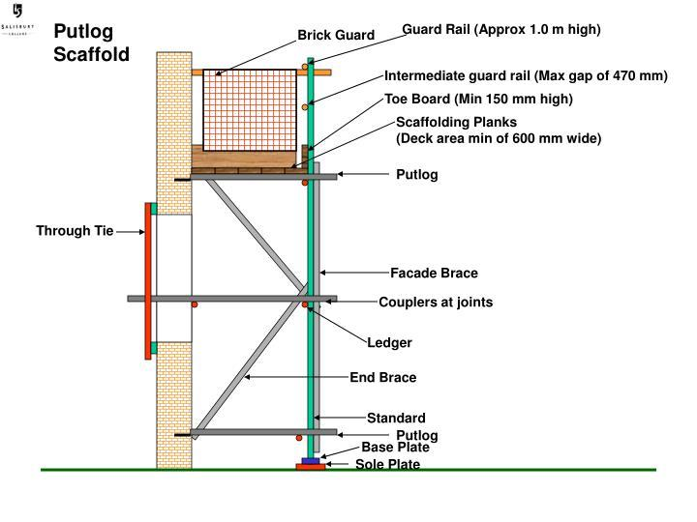
Single scaffolding
Single scaffolding includes the putlog scaffolding system, and is mostly used in brick masonry. It is a scaffolding system that uses the structure being built as its support.

Slide 29
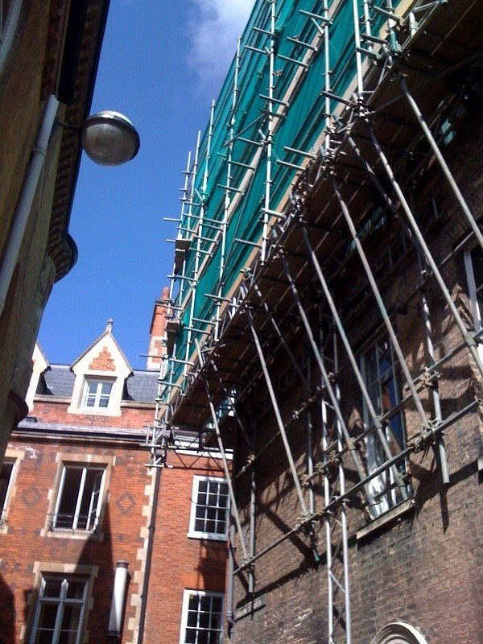
Cantilever Scaffolding
Cantilever scaffolding is ideal in situations where the ground surface does not allow for setting up a regular scaffolding system. It is also known as needle scaffolding, because needles provide the foundation for the scaffold. Needles are extended out from the wall of a building on which a working platform is set up.

Slide 30
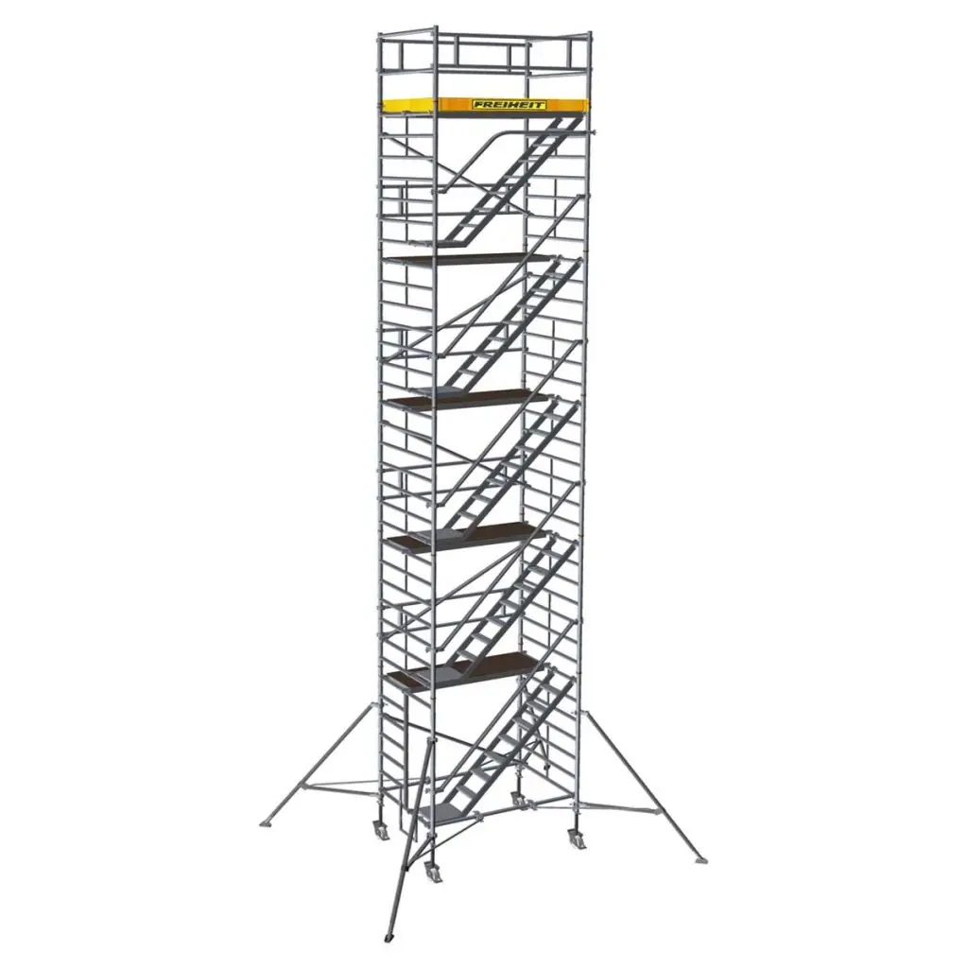
Mobile scaffolding
Mobile scaffolding provides portable working platforms that can easily be moved to the location that needs work. Mobile scaffolds sit on castors to allow workers to perform tasks that require frequent change in position. Some of these include mobile towers, genie lifts, and square tower.

Slide 31
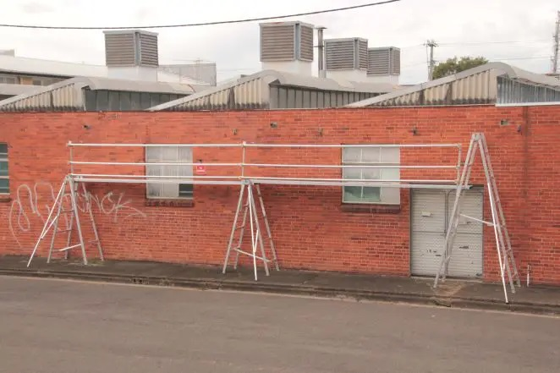
Trestle scaffolding
Trestle scaffolds are used for light duty work. They have adjustable legs so their height can be modified depending on the situation.

Slide 32
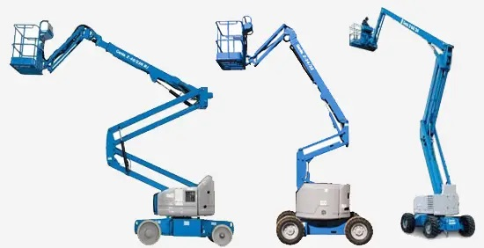
Aerial Lifts
Aerial lifts are excellent for short term projects that cover a small area. These are either powered or manually driven to the required height by a structure underneath. They are primarily used for renovation and maintenance projects. However, some construction projects also employ aerial lifts if the task can be completed in a short time. Some examples include scissor lifts, bucket truck, and boom lift.

Slide 33
Construction planning and site constraints
A Constraint is a condition, agency or force that impedes progress towards and objective or goal.
There are a number of different types of constraints that can affect construction projects.
Constraints should be identified, and described in as much detail as possible during the early stages of a project, so that awareness of them and their potential impact can be managed. This includes understanding the dynamics of the project and how different constraints interrelate, as well as being clear about any potential risks and who is responsible for them.
Design constraints:
These are factors that limit the range of potential design solution that can be adopted.
They may be inherent in the type of building required or site or they may be imposed by the client or a third party.

Slide 34
Types of design constraints
Available technology, skills, plant, materials, labour and so on.
The budget.
Specific performance requirements.
Site form, boundaries, conditions and neighbouring properties.
Site access, rights of way, rights to light and so on.
Local infrastructure.
Planning and building regulations restrictions.
Completion date.
Local climatic conditions.

Slide 35
DESIGN OF FORMWORK AND CONSTRUCTION SAFETY
UNIT -1
INTRODUCTION

Slide 36
Planning for maximum reuse – Economical form construction
Benefits of Reuse of materials:
Reduced waste disposal costs covering both transportation and disposal;
Avoidance of primary material use reducing cost of build;
Raised staff awareness of re-use opportunities for future projects;

Slide 37
Cost savings associated with re-use of site won materials can include:
• Reduced need to purchase new materials: cost savings associated with recovery and re-use of items from demolition, e.g. bricks, ornamental objects, high value materials;
• Savings from reduced waste management costs;

Slide 38
Materials to be re-used
Material | Examples of products | Re-use opportunity
Excavated material | Top soil, concrete, rubble, clay. | Can be re-used on-site as fill, stabilising soils using hydraulic binders, manufacturing quality soils by adding ‘green’ compost, and re-mediating brownfield land in-situ.
Brick, concrete and masonry | Common / building bricks, fire or refractory bricks, ceramic glazed, engineering bricks, paving. Masonry: Marble, granite travertine, limestone, cast stone, concrete block, glass block and cob. | Material arising from demolition can be processed on-site and used as fill, sub-base material or driveway / car parking substructure.
Ironwork | Wrought iron, cast iron and early steel columns, conservatories, windows, doors trusses, frames, features and staircases. | Sell materials for re-use to scrap groups. Ironwork could be used on other construction projects.

Slide 39
DESIGN OF FORMWORK AND CONSTRUCTION SAFETY
UNIT -3
Shoring, Formwork and Accessories

Slide 40
Syllabus
Simple wood stresses
Slenderness ratio
Allowable loads
Tubular steel shores
Patented shores
Site preparation
Size and spacing
Steel tower frames
Safety practices
Horizontal shoring for multilevels
More concentrated shore loads
Basic simplification
Beam formulae
Allowable stresses
Deflection bending lateral stability
Shear, bearing
Examples of wall forms
Slab forms
Beam forms
Ties, Anchors and Hangers
Column forms
Examples

Slide 41
Simple wood stresses
The compressive strength in the direction parallel to the grain is around more than 10 times the strength perpendicular to the grain.
The tensile strength in the direction parallel to the grain is about more than 30 times the strength perpendicular to the grain.
The tensile strength parallel to the grain is larger than the compressive strength in the same direction
Bending strength: loading a block perpendicular to the grain.
Shear strength : application of stress from two opposite direction causing portions of an object to move in parallel but opposite direction.

Slide 42
Slenderness Ratio
It is defined as the effective length of the column and is the least radius of gyration

Slide 43
Shoring
The process of supporting a structure in order to prevent a collapse so that construction can proceed, provide safety for workers in a trench and speeding excavation.
https://www.youtube.com/watch?v=yM-EJ55Dd04

Slide 44
Types of shoring
H or I section shoring
Second pile shoring
Contiguous pile shoring
Sheet piles
Diaphram walls
https://www.youtube.com/watch?v=PXy-93Q4mFc

Slide 45
Types of shoring
H or I section shoring
Secant pile shoring
Contiguous pile shoring
Sheet piles
Diaphragm walls

Slide 46
H or I section shoring
H or I-Beam Shoring also known as soldier pile walls are the most common type of shoring that we usually encountered in a construction project. It is constructed by driving prefabricated steel I or H sections into the ground. Soil conditions may allow for the sections to be vibrated directly into the ground instead of the pre-drilling of the soil before installing the beam. The full wall is formed by installing a pre-cast concrete panel between the driven steel beams to construct the shoring walls.
H or I-Beam Shoring was used to support an excavation ranging from 1.2 to 5.0 meters deep or excavations equivalent to at least one basement and depending on the design, its toe length ranges from 10 meters to 12 meters depth from 0.00 levels. You can go beyond 5 meters provided that it is properly designed and calculated to sustain the given surcharge load along its outside perimeter.

Slide 47
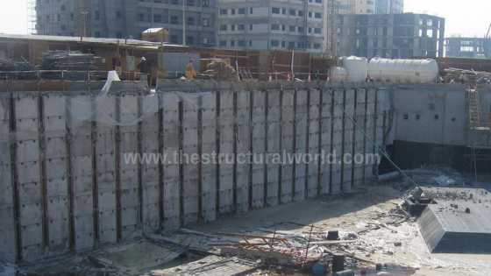

Slide 48
Secant pile shoring
Secant Pile Shoring was formed of intersecting two combinations of piles, with a “reinforced”, also called as secondary and “un-reinforced” or primary pile interlocking each other to form a continuous wall. A guide beam is constructed first prior to installation to keep the alignment in place. This is usually used in deep excavations. After casting the “primary” pile, the temporary casing is extracted while the concrete has not fully set and the heavy casing is then driven into the intervening pile location cutting into the fresh concrete of the adjacent pile. The “secondary” piles are then immediately drilled. The steel cages of the “secondary” pile are inserted and the structural concrete is poured to form a continuous wall.
Secant Pies are the best choice to use when there is no room for open excavation or when space is limited because of an existing structure that was too close in proximity. In this case a surcharge loads due to the neighboring structure is considered in the design.

Slide 49
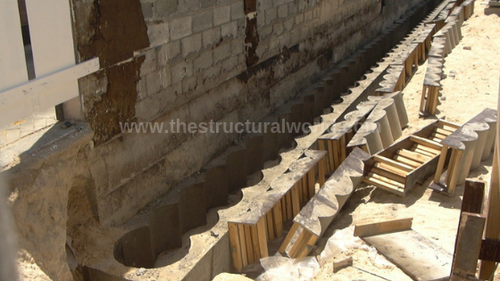
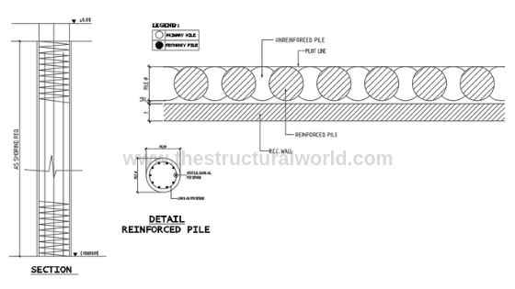

Slide 50
Contiguous pile shoring
Contiguous or Tangent Pile Shoring is composed of closely spaced piles wherein the faces of the piles are almost touching or tangent with each other. This is used in areas where water is not significant or the water pressure is very minimal. This is usually proposed in clay soils and can use to retain dry granular material or fills. Although water seepage between the gaps of the pile is more likely to occur when used in water-bearing granular soils, it can be prevented by grouting these gaps to form a water-tight retaining wall. This type of shoring is not recommended to use in high ground water table without dewatering works.
Construction of contiguous pile is very similar to that of the secant piles as prior to the installation, a guide beam should be constructed to serve as a guide for the contiguous wall to install in place.

Slide 51
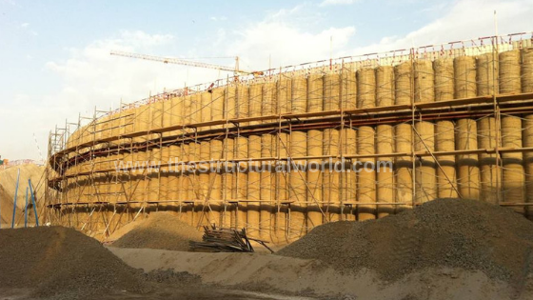
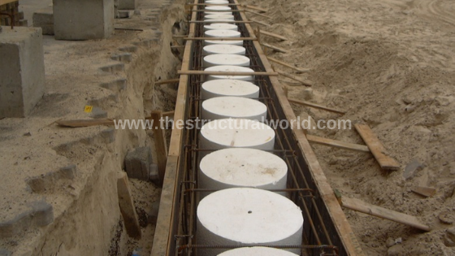

Slide 52
Sheet piles
Although it can be used to retain soil to soil excavations, this type of shoring is bests to use when we need to isolate our excavation from the bodies of water specifically a creek, a pond or on a sea-side. It is commonly seen in a port and harbor construction. Similar to soldier piles, it can be constructed by driving prefabricated Z or U steel sections into the ground using a Vibro hammer. The full wall was formed connecting the Z or U steel sections or the sheet piles. Depending on the depth of excavation, the end of the sheet piles if not long enough can be welded together to reach the desired depth in the ground.

Slide 53
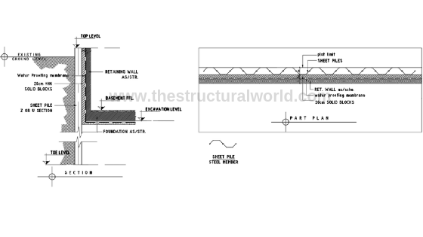

Slide 54
Diaphragm walls
When the excavations are too deep for the type of shoring, diaphragm walls can be used. It is made of reinforced concrete designed primarily according to loads that needs to be resisted. It can be the element for a temporary or permanent retaining wall or both. For the deep excavation of the basement and tunnels, the diaphragm wall is the best option.

Slide 55
